Slide 1
E-COMMERCE
BROKEN?

Slide 2

INTERNET OF
PRODUCTS
E-COMMERCE
BROKEN?

Slide 3

TOO MANY

Slide 4

UNSAFE

Slide 5

NO PRIVACY

Slide 6

paratar
PARATAR

Slide 7
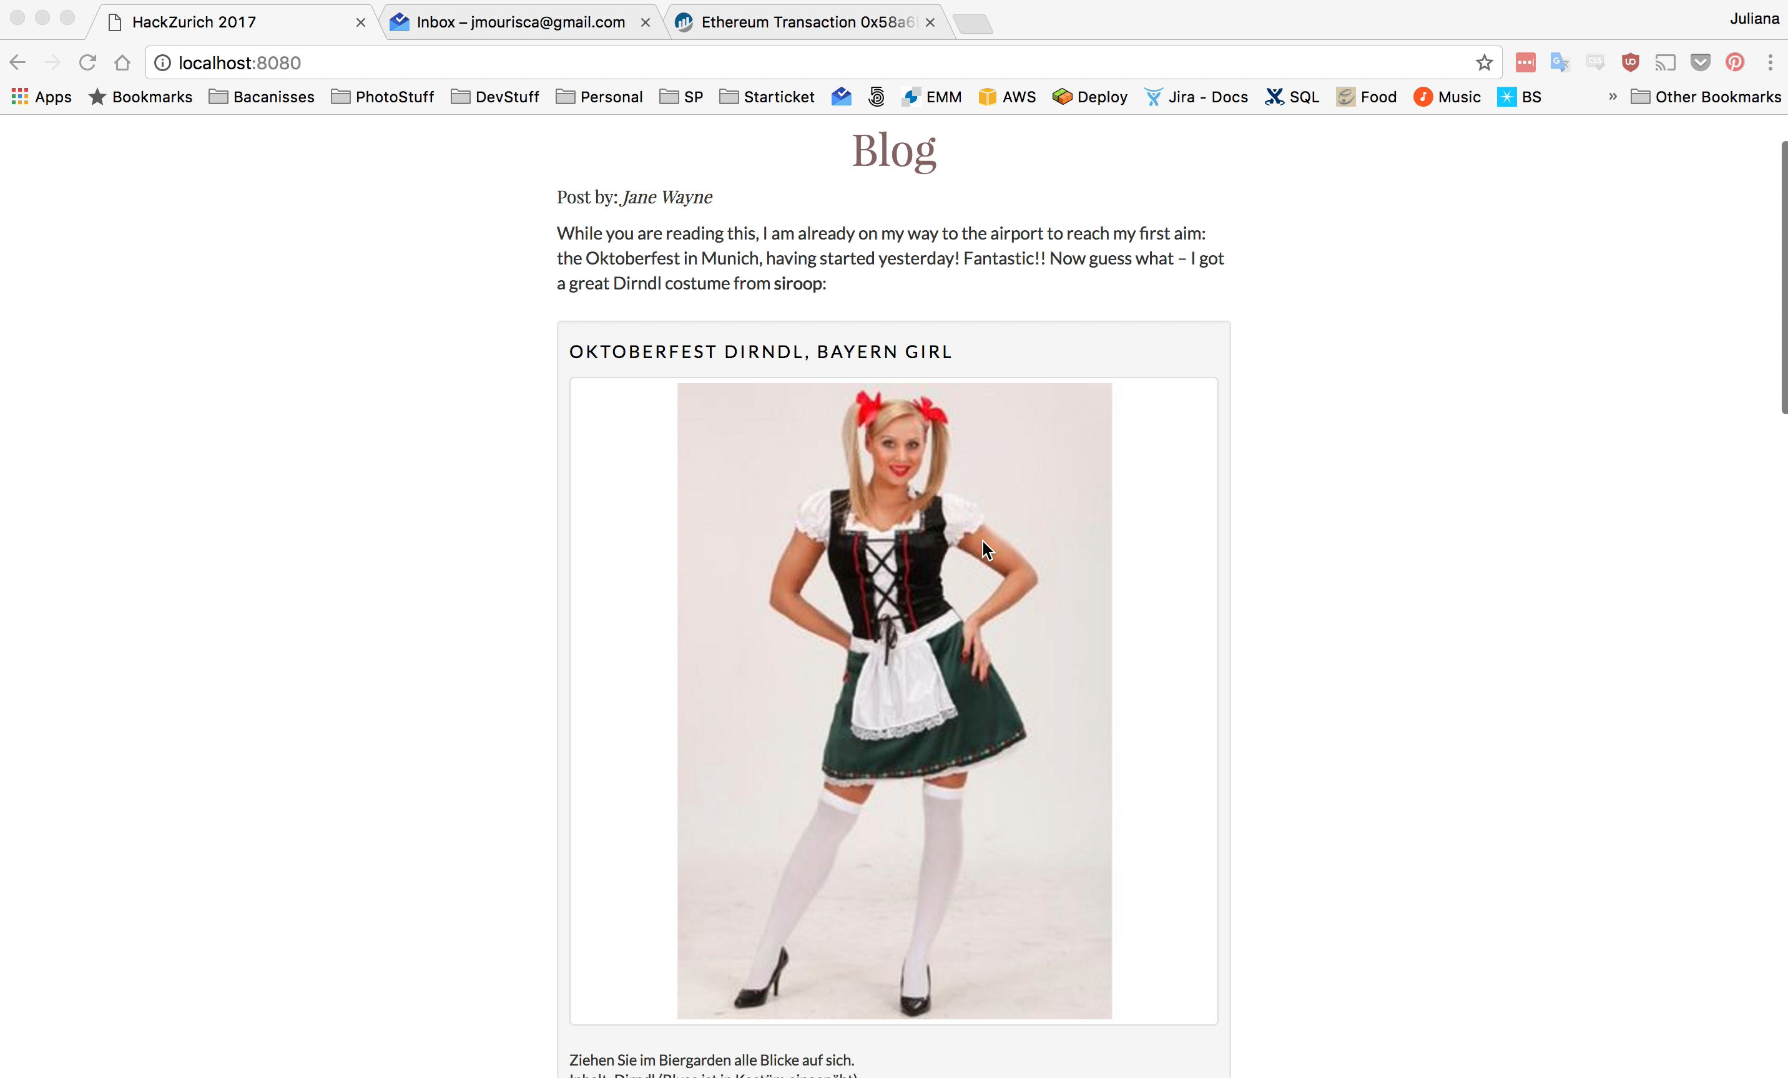

Slide 8
e-commerce ux is broken
TOO MANY
and insecure payment structures confuse consumers.
46% of all Americans has been victim of credit card fraud in the last 5 years
UNFAIR
payment structure to address third party sales channels
UNNECESSARY CHARGES
taken by third party payment providers. It is your money
INCOMPREHENSIBLE TOS
nobody understands and nobody reads ToS
ALWAYS GIVING AWAY
personal data by re-registering for each new online shops

Slide 9
paratar
fixing e-commerce

Slide 10
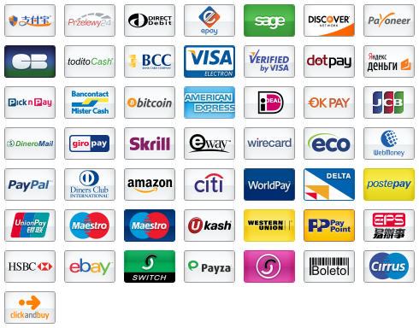
TOO MANY

Slide 11
IS E-COMMERCE UX BROKEN?

Slide 12
TOO MANY

Slide 13

UNSAFE

Slide 14

PERSONAL DATA

Slide 15
And this is how we fix it

